Slide 1
UNIT - I
INTRODUCTION

Slide 2
SECURITY SERVICES
Authentication
Access Control
Data Integrity
Data Confidentiality
Nonrepudiation

Slide 3
Security mechanisms
Specific security mechanisms
→ Encipherment
→ Digital Signature
→ Access Control
→ Data Integrity
→ Traffic Padding
→ Routing Control
→ Notarization
→ Authentication Exchange

Slide 4
Contd….
Pervasive Security Mechanisms
→ Trusted Functionality
→ Security Label
→ Event Detection
→ Security Audit Trail
→ Security Recovery

Slide 5
A MODEL FOR NETWORK SECURITY
All the techniques for providing security have two components:
→ A security-related transformation on the information to be sent.
→ Some secret information is shared by the two principals and, it is hoped, unknown to the opponent.

Slide 6
CONTD…
Design an algorithm for performing the security-related transformation.
Generate the secret information to be used with the algorithm.
Develop methods for the distribution and sharing of secret information.
Specify a protocol to be used by the two principals that make use of the security algorithm and the secret information to achieve a particular security service.

Slide 7
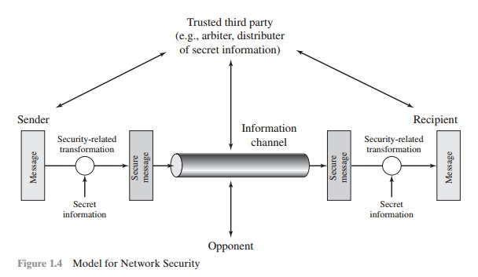
A MODEL FOR NETWORK SECURITY

Slide 8
Conventional encryption principles
Plaintext − This is the authentic intelligible message or information that is full into the algorithm as input.
Encryption algorithm − The encryption algorithm implements several substitutions and conversion on the plaintext.
Secret key − The secret key is also input to the encryption algorithm. The key is a value autonomous of the plaintext and of the algorithm. The algorithm will create a multiple output based on the definite key being utilized at the time. The exact substitutions and conversion implemented by the algorithm depend on the key.
Cipher text − This is the chaotic news created as output. It is based on the plaintext and the secret key. For a given message, there are two different keys will create two different cipher texts. The cipher text is a seemingly random flow of information and as it stands is unintelligible.
Decryption algorithm − This is basically the encryption algorithm run in opposite. It takes the cipher text and the secret key and creates the initial plaintext.

Slide 9
Requirements for use of cep
It is required a strong encryption algorithm. At a minimum, it is an algorithm to be such that an opponent who understand the algorithm and has access to one or more cipher texts would be inadequate to decipher the cipher text or consider the key.
Sender and receiver should have obtained copies of the secret key in a secure fashion and should maintain the key secure. If someone can find the key and understand the algorithm, all communication utilizing this key is readable.

Slide 10
cryptography
The type of operations used for transforming plaintext to cipher text. All encryption algorithms are based on two general principles: substitution, in which each element in the plaintext (bit, letter, group of bits or letters) is mapped into another element, and transposition, in which elements in the plaintext are rearranged. The fundamental requirement is that no information be lost (that is, that all operations be reversible). Most systems, referred to as product systems, involve multiple stages of substitutions and transpositions.
The number of keys used. If both sender and receiver use the same key, the system is referred to as symmetric, single-key, secret-key, or conventional encryption. If the sender and receiver each use a different key, the system is referred to as asymmetric, two-key, or public-key encryption.
The way in which the plaintext is processed. A block cipher processes the input one block of elements at a time, producing an output block for each input block. A stream cipher processes the input elements continuously, producing output one element at a time, as it goes along.

Slide 11
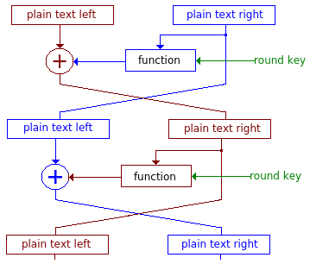
FEISTEL CIPHER STRUCTURE

Slide 12
CONVENTIONAL ENCRYPTION ALGORITHMS
DES ( DATA ENCRYPTION STANDARD)
3 DES
AES ( ADVANCED ENCRYPTION STANDARD)

Slide 13
DATA ENCRYPTION STANDARD
Data Encryption Standard (DES) is a block cipher with a 56-bit key length that has played a significant role in data security. Data encryption standard (DES) has been found vulnerable to very powerful attacks therefore, the popularity of DES has been found slightly on the decline. DES is a block cipher and encrypts data in blocks of size of 64 bits each, which means 64 bits of plain text go as the input to DES, which produces 64 bits of cipher text. The same algorithm and key are used for encryption and decryption , with minor differences. The key length is 56 bits.

Slide 14
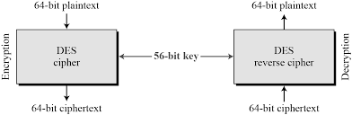
Contd…

Slide 15
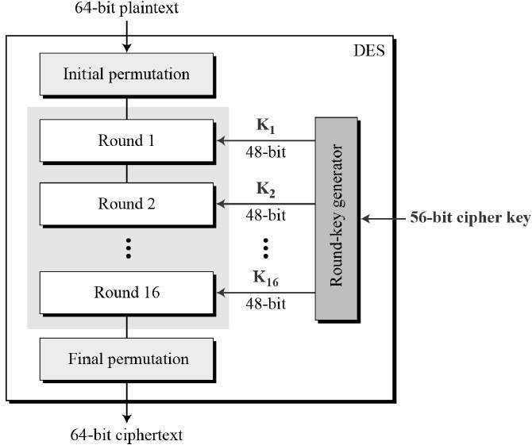
Contd…

Slide 16
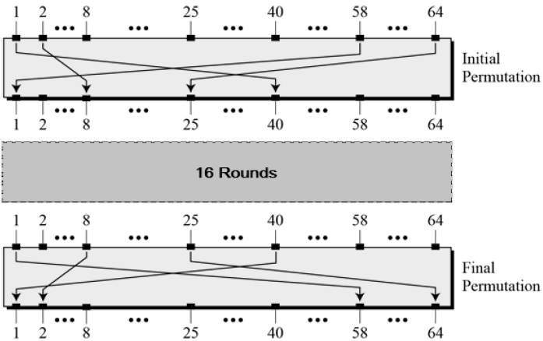
Contd…

Slide 17
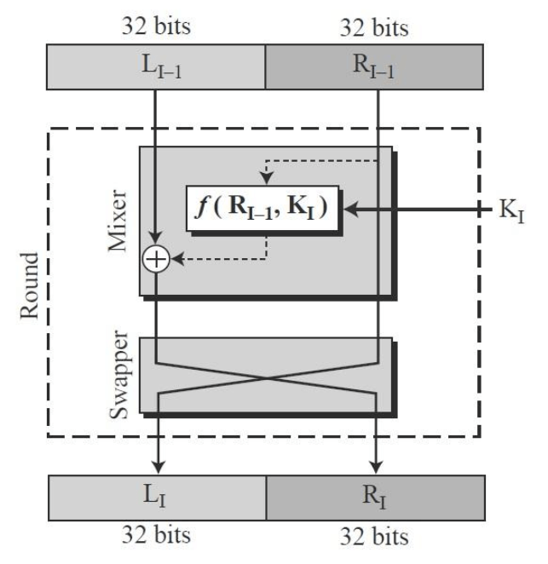
Contd…

Slide 18
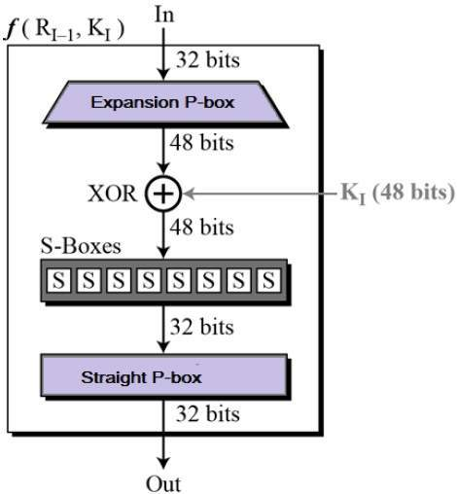
Round function

Slide 19

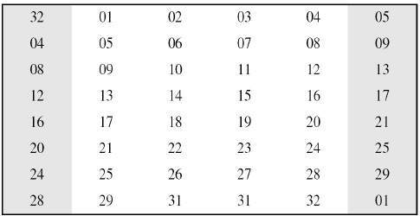
Contd…

Slide 20
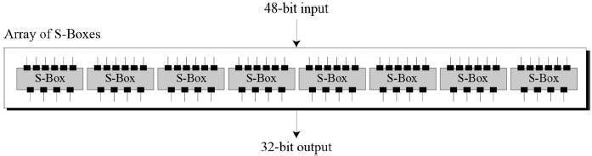
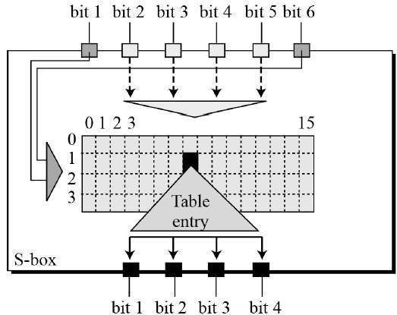
Contd…

Slide 21
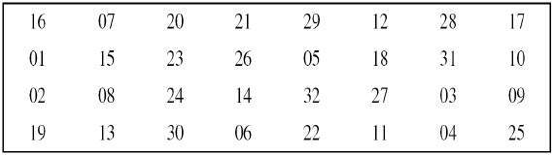
Contd…

Slide 22
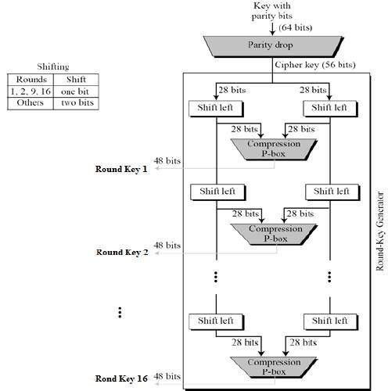
Round key generator

Slide 23
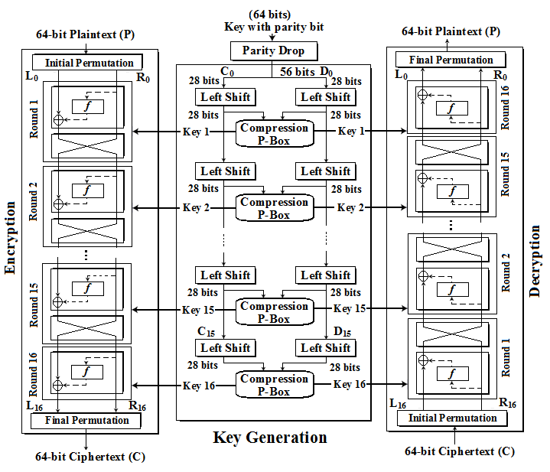
Complete structure of des

Slide 24
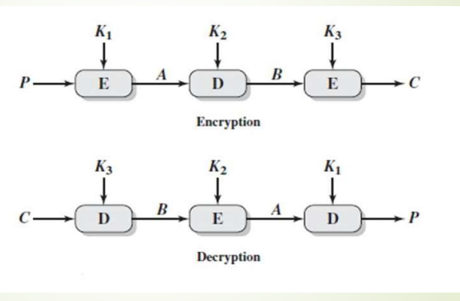
3 DES
Triple DES is an encryption algorithm based on the original Data Encryption Standard (DES). It is a symmetric encryption algorithm that uses multiple rounds of the Data Encryption Standard (DES) to improve security.

Slide 25
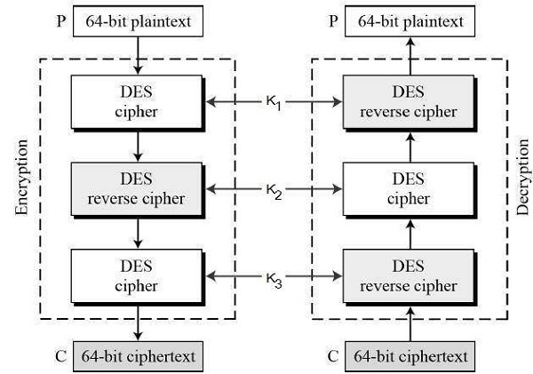
CONTD…

Slide 26
Contd…
Encrypt the plaintext blocks using single DES with key K₁.
Now decrypt the output of step 1 using single DES with key K₂.
Finally, encrypt the output of step 2 using single DES with key K₃.
The output of step 3 is the cipher text.
Decryption of a cipher text is a reverse process. User first decrypt using K_{3,} then encrypt with K_{2,} and finally decrypt with K₁.

Slide 27
CONTD…
C = E(K3, D(K2, E(K1, P)))
where
C = cipher text
P = plaintext
E[K, X] encryption of X using key K
D[K, Y] decryption of Y using key K
Decryption is simply the same operation with the keys reversed
P = D(K1, E(K2, D(K3, C)))

Slide 28
aes
A replacement for DES was needed as its key size was too small. With increasing computing power, it was considered vulnerable against exhaustive key search attack. Triple DES was designed to overcome this drawback but it was found slow.
AES is an iterative rather than Feistel cipher. It is based on ‘substitution–permutation network’. It comprises of a series of linked operations, some of which involve replacing inputs by specific outputs (substitutions) and others involve shuffling bits around (permutations).
Interestingly, AES performs all its computations on bytes rather than bits. Hence, AES treats the 128 bits of a plaintext block as 16 bytes.

Slide 29
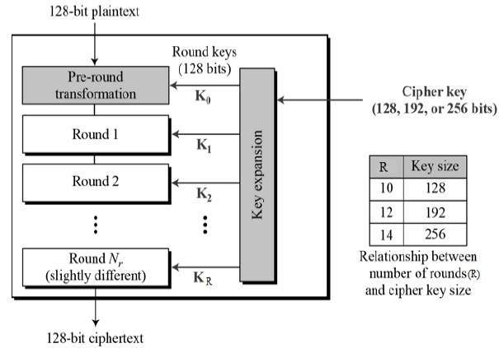
Aes structure

Slide 30
Data Units
BIT
BYTE
WORD
BLOCK
STATE

Slide 31
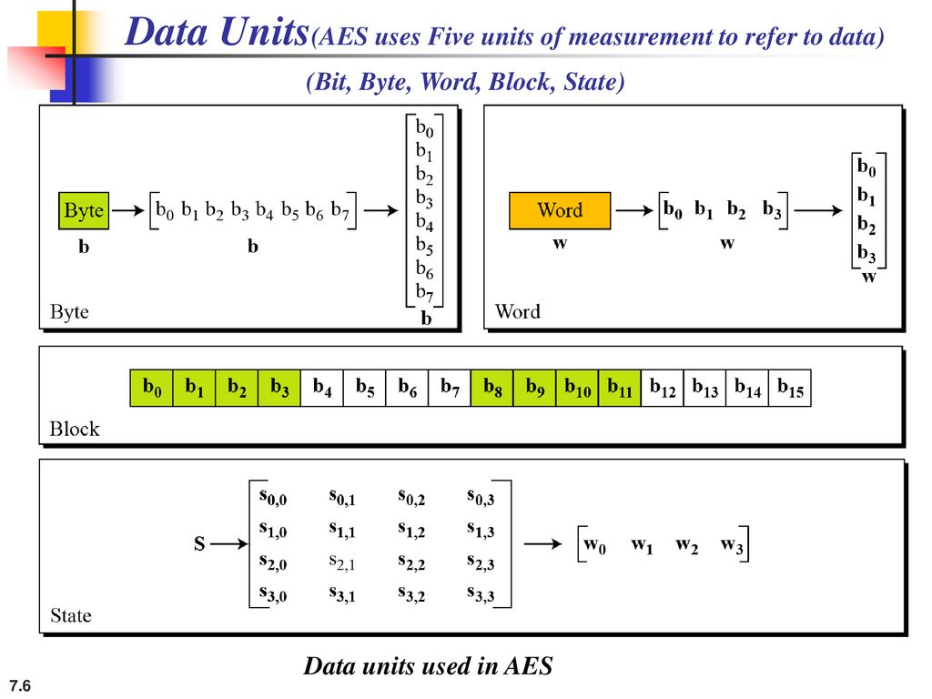
CONTD…

Slide 32
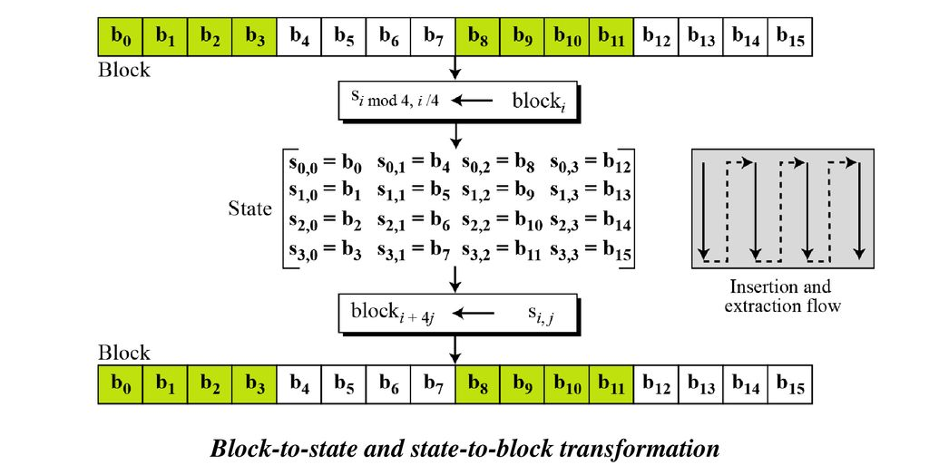
CONTD…

Slide 33
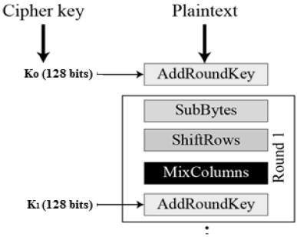
Encryption process of aes

Slide 34
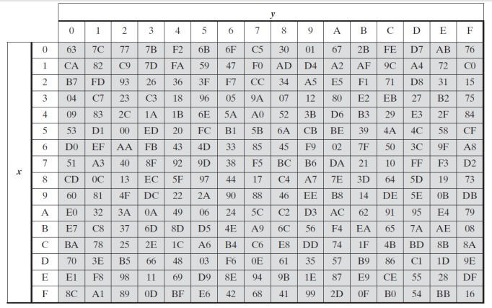
Substitute bytes

Slide 35
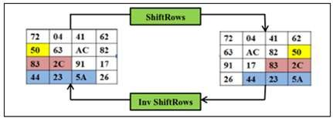
Shift rows

Slide 36
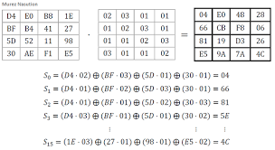
Mix columns

Slide 37
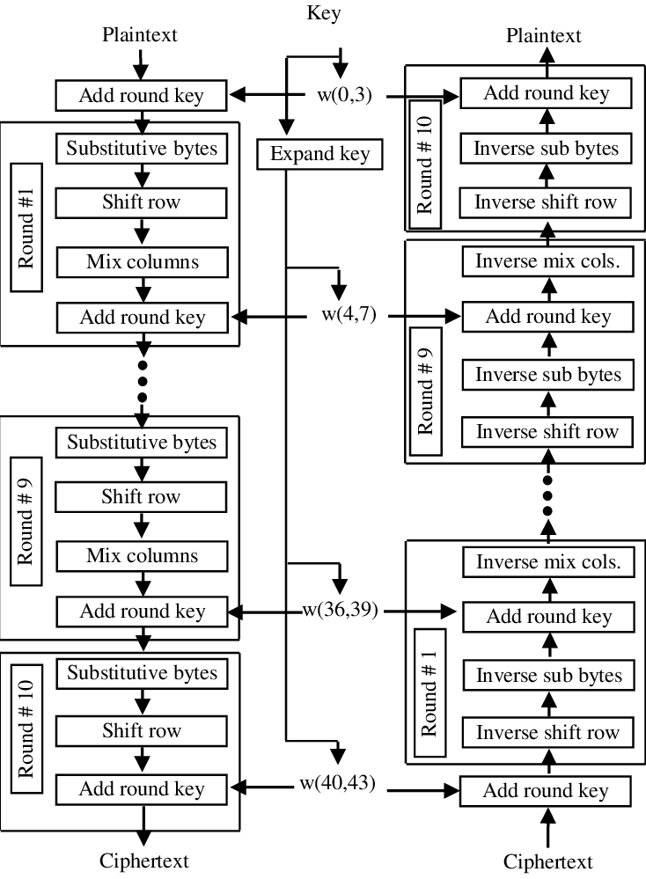
AES COMPLETE STRUCTURE

Slide 38
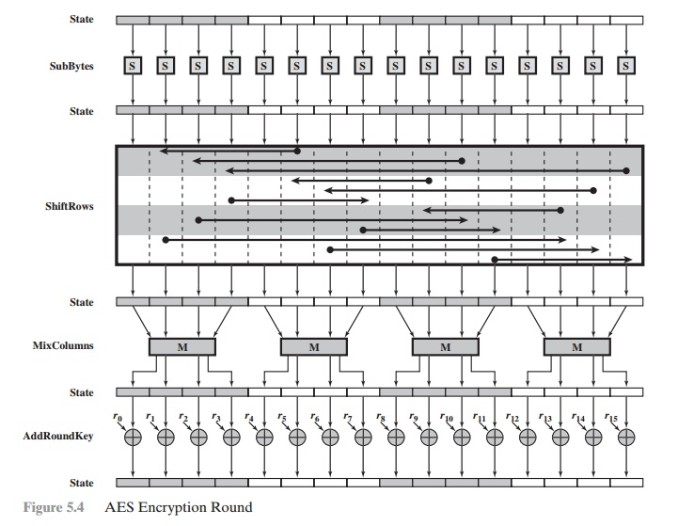
AES ROUND FUNCTION

Slide 39
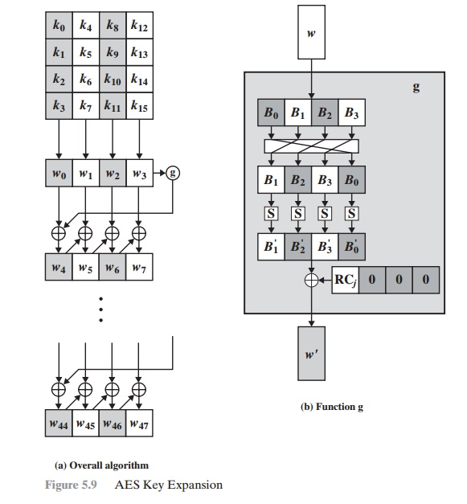
AES KEY EXPANSION

Slide 40
CIPHER BLOCK MODE OF OPERATIONS
A symmetric block cipher processes one block of data at a time. In the case of DES and 3DES, the block length is b = 64 bits, for AES the block length is b = 128 bits. For longer amounts of plaintext, it is necessary to break the plaintext into b-bit blocks (padding the last block if necessary). To apply a block cipher in a variety of applications, five modes of operation have been defined.
→ Electronic Codebook Mode
→ Cipher Block Chaining Mode
→ Cipher Feedback Mode
→ Output Feedback Mode
→ Counter Mode

Slide 41
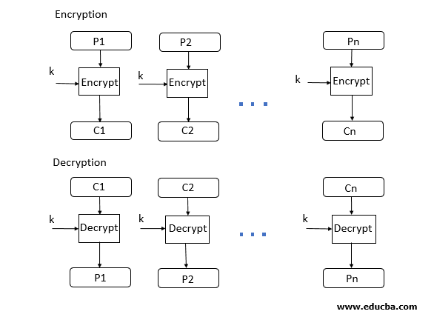
Electronic Codebook Mode
Electronic code book is the easiest block cipher mode of functioning. It is easier because of direct encryption of each block of input plaintext and output is in form of blocks of encrypted cipher text. Generally, if a message is larger than b bits in size, it can be broken down into a bunch of blocks and the procedure is repeated.

Slide 42
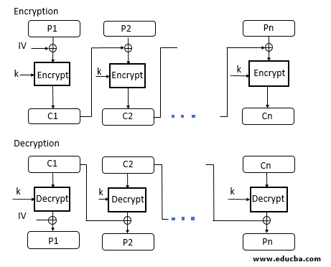
Cipher Block Chaining Mode
Cipher block chaining or CBC is an advancement made on ECB since ECB compromises some security requirements. In CBC, the previous cipher block is given as input to the next encryption algorithm after XOR with the original plaintext block.

Slide 43
Cipher Feedback Mode
In this mode the cipher is given as feedback to the next block of encryption with some new specifications: first, an initial vector IV is used for first encryption and output bits are divided as a set of s and b-s bits. The left-hand side s bits are selected along with plaintext bits to which an XOR operation is applied. The result is given as input to a shift register having b-s bits to LHS,s bits to RHS and the process continues. The encryption and decryption process for the same is shown below, both of them use encryption algorithms.

Slide 44
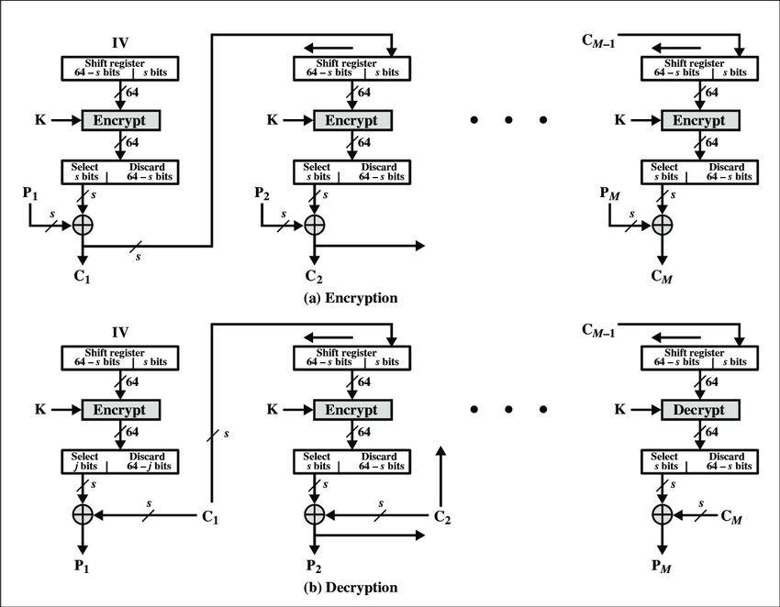
CONTD…

Slide 45
Output Feedback Mode
The output feedback mode follows nearly the same process as the Cipher Feedback mode except that it sends the encrypted output as feedback instead of the actual cipher which is XOR output. In this output feedback mode, all bits of the block are sent instead of sending selected s bits. The Output Feedback mode of block cipher holds great resistance towards bit transmission errors.

Slide 46
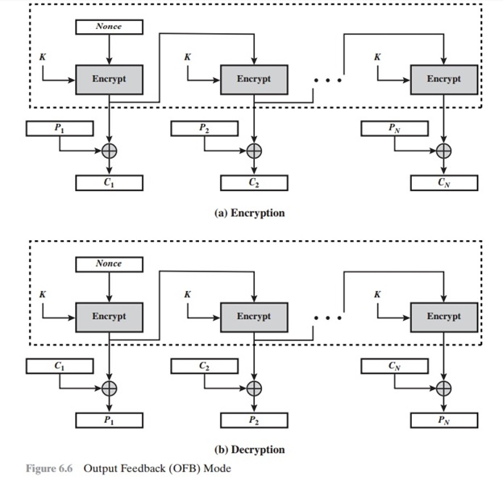
CONTD…

Slide 47
Counter Mode
The Counter Mode or CTR is a simple counter-based block cipher implementation. Every time a counter-initiated value is encrypted and given as input to XOR with plaintext which results in ciphertext block. The CTR mode is independent of feedback use and thus can be implemented in parallel.

Slide 48
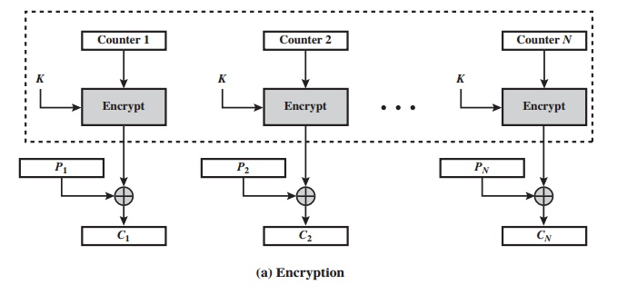
CONTD…

Slide 49
Stream Ciphers and RC4
A block cipher processes the input one block of elements at a time, producing an output block for each input block. A stream cipher processes the input elements continuously, producing output one element at a time as it goes along.

Slide 50
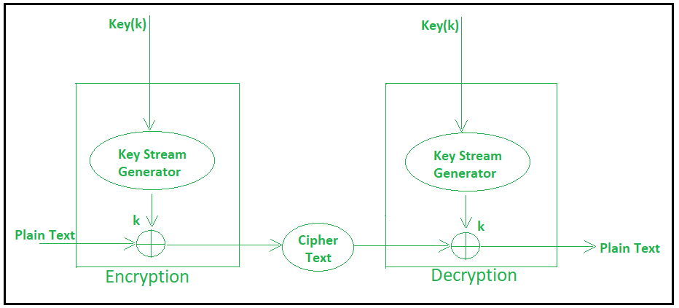
Contd…

Slide 51
contd…
For example, if the next byte generated by the generator is 01101100 and the next plaintext byte is 11001100, then the resulting cipher text byte is
11001100 plaintext
⊕ 01101100 key stream
10100000 cipher text
Decryption requires the use of the same pseudorandom sequence:
10100000 ciphertext
⊕ 01101100 key stream
11001100 plaintext

Slide 52
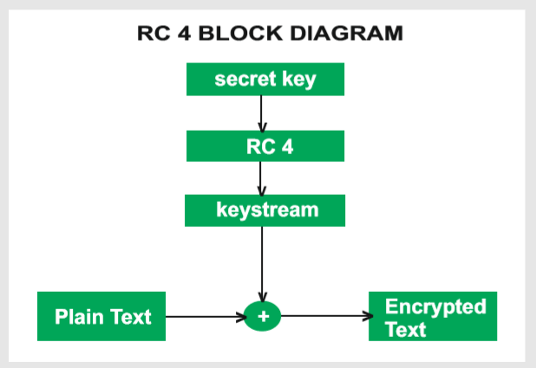
RC4 ALGORITHM
RC4 means Rivest Cipher 4 invented by Ron Rivest in 1987 for RSA Security. It is a Stream Ciphers. Stream Ciphers operate on a stream of data byte by byte. RC4 stream cipher is one of the most widely used stream ciphers because of its simplicity and speed of operation.

Slide 53
Steps of rc4 algorithm
Key Scheduling
Key Stream Generation
Encryption & Decryption

Slide 54
KEY SCHEDULING
j = 0
for i = 0 to 255 do
j = [j+s(i) +T(i)] mod 256 // s[i] = state vector
swap (s[i],s[j]) // T(i) = key array

Slide 55
INITIALIZATION
for i 0 to 255 do
S[i] = i;
T[i] = K[i mod keylen];

Slide 56
STREAM GENERATION
No. of iterations = size of the key
i,j = 0;
while(true)
i = (i+1) mod 256;
j = (j+s[i]) mod 256;
swap( s[i],s[j]);
t = (s[i]+s[j]) mod 256
k = s[t];

Slide 57
ENCRYPTION & DECRYPTION
Enc : PT XOR NEW KEY
Dec: CT XOR NEW KEY

Slide 58
Location of Encryption Devices
The most powerful and most common approach to countering the threats is encryption. If encryption is used to counter these threats, then we need to decide what to encrypt and where the encryption gear should be located. There are two fundamental alternatives * Link encryption * end to end encryption.

Slide 59
LiNK ENCRYPTION
With link encryption, each vulnerable communications link is equipped on both ends with an encryption device. Thus, all traffic over all communications links is secured.
Although this requires a lot of encryption devices in a larger network, the value of this approach is clear.
One disadvantage of the approach is that the message must be decrypted each time it enters a packet switch; description is necessary because the switch must read the address in the packet header to route the packet.

Slide 60
end to end encryption
With end to end encryption, the encryption process is carried out at the two end systems. The source host or terminal encrypts the data.
The data is encrypted form are then transmitted unaltered across the network to the destination terminal, or host.
The destination shares a key with the source and so is able to decrypt the data.

Slide 61
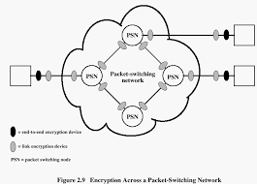
ARCHITECTURE

Slide 62
KEY DISTRIBUTION
For symmetric encryption to work, the two parties to an exchange must share the same key, and that key must be protected from access by others. Furthermore, frequent key changes are usually desirable to limit the amount of data compromised if an attacker learns the key.
For two parties A and B, there are the following options:
1. A key could be selected by A and physically delivered to B.
2. A third party could select the key and physically deliver it to A and B.
3. If A and B have previously and recently used a key, one party could transmit the new key to the other, using the old key to encrypt the new key.
4. If A and B each have an encrypted connection to a third party C, C could deliver a key on the encrypted links to A and B.

Slide 63
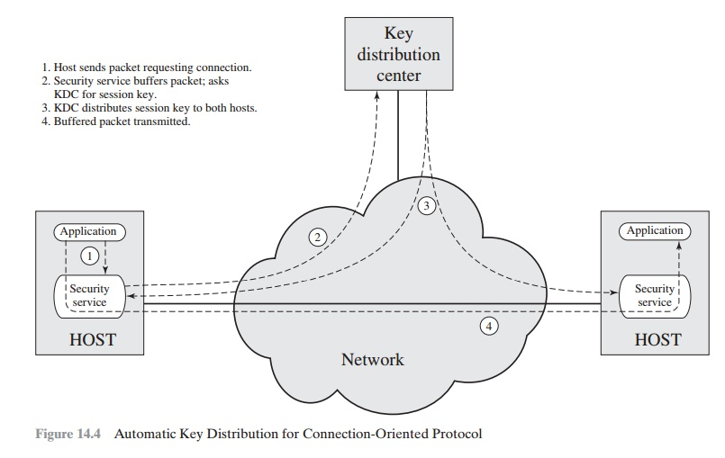
architecture

